Slide 1
Tech Tickets
Keeping Track of your it service calls

Slide 2
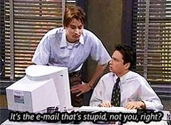
Problem: keeping track of IT inventory and techs jobs.

Slide 3
Relational tables

Slide 4
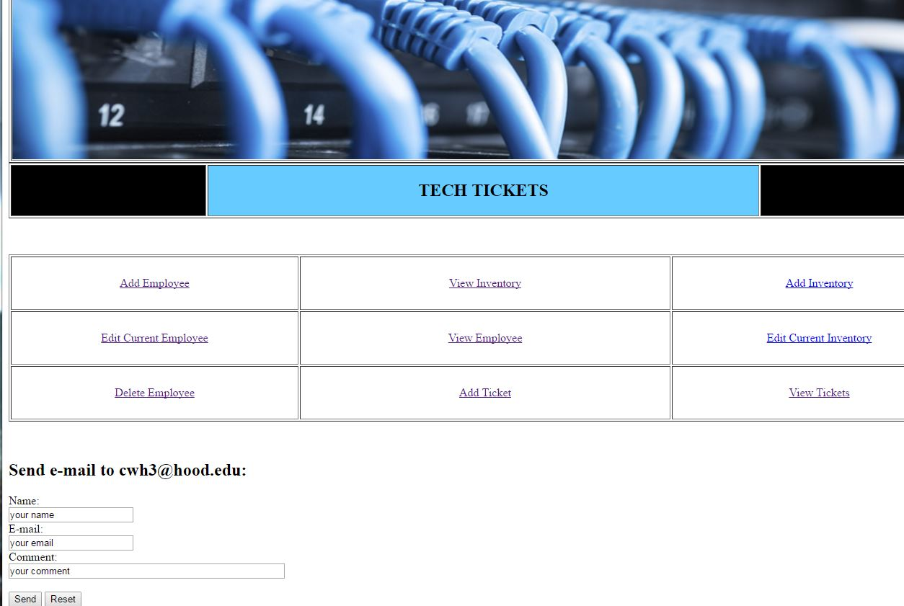
Index file Central hub to navigate all functions in program. Can email webmaster for any problems with the program.

Slide 5
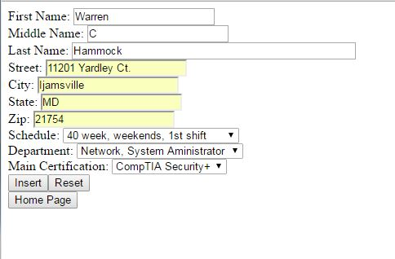
Add employee/tech allows you to insert a new employee/tech. Drop down menu for schedule, department, and main certification. HERE WE ARE INSERTING WARREN C HAMMOCK.

Slide 6
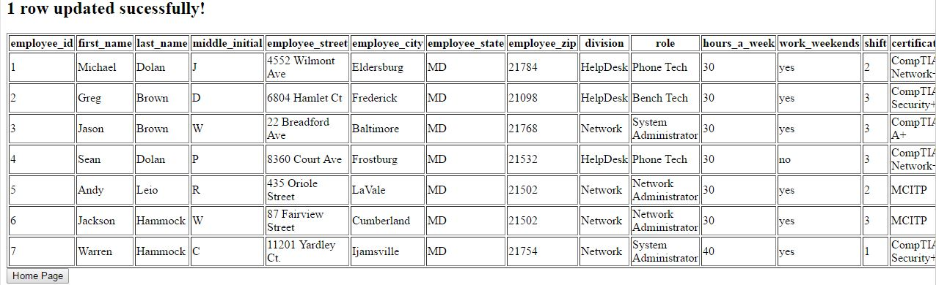
Employee/tech added warren c hammock was added to the employee table.

Slide 7
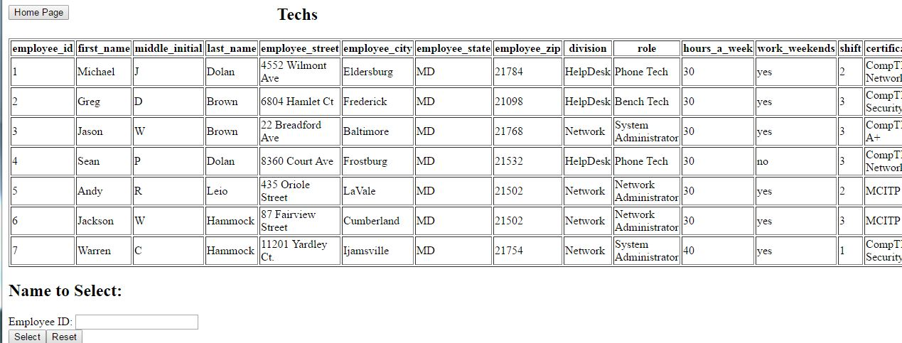
Edit employee table select an employee by using employee_id and populate next page with attributes.

Slide 8
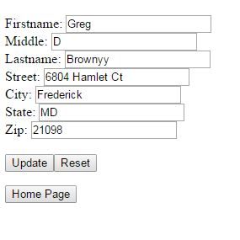
Edit employee form here we are changing greg d brown to greg d brownyy. You can also see the last 6 attributes are not populated due to the issues I was having pushing the data to a drop down menu.

Slide 9
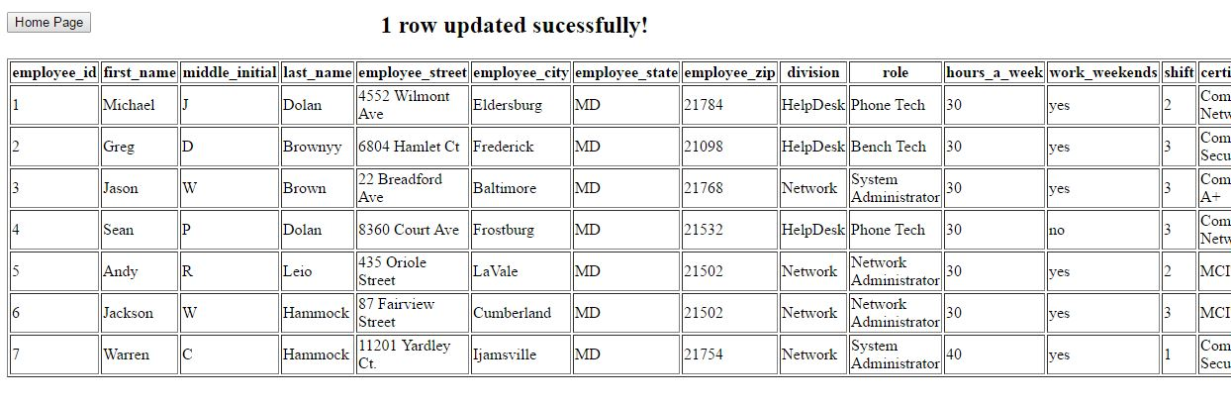
Edit employee/tech final shows that greg d brown is now greg d brownyy.

Slide 10
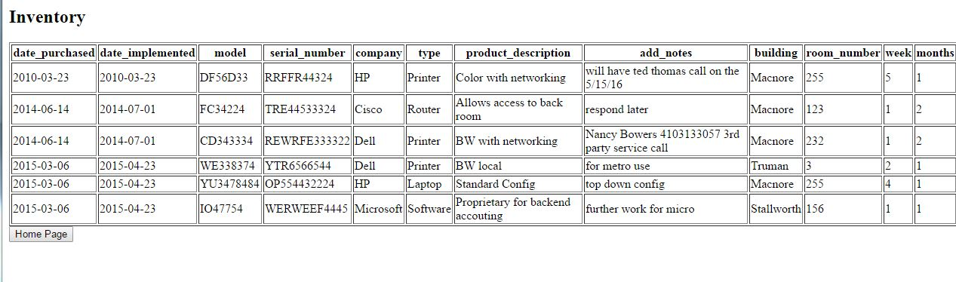
View inventory

Slide 11
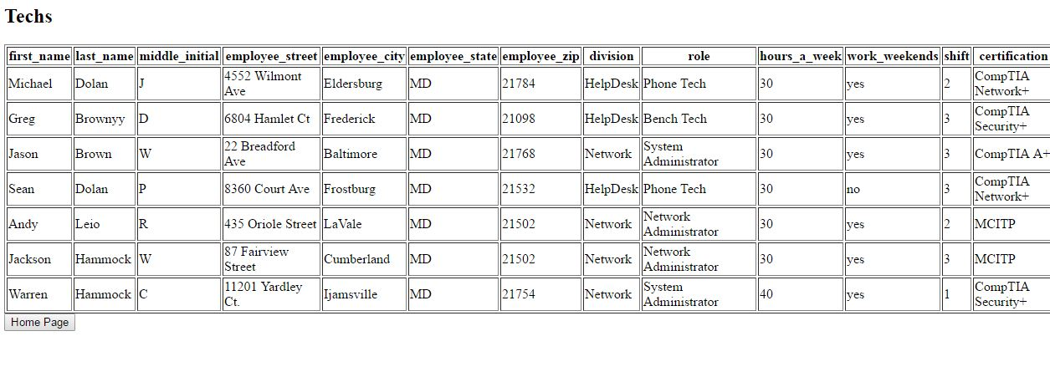
View techs

Slide 12
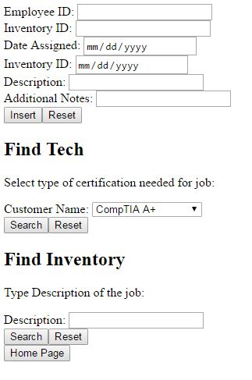
Add ticket main main interface for adding a ticket . Reason why both searches are not in the same function is lack of experience in executing multiple queries in php statement.

Slide 13
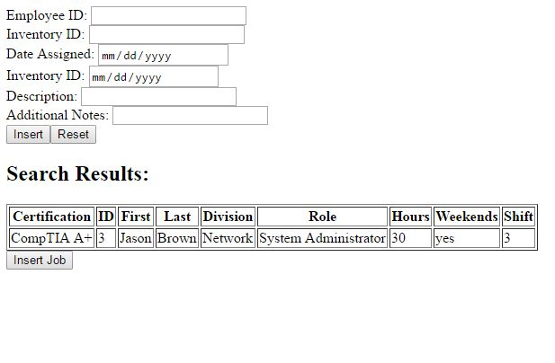
Search techs by certification

Slide 14
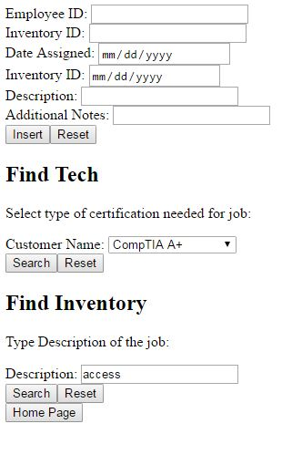
Search description of inventory allows to search inventory by description using the key word “access”

Slide 15
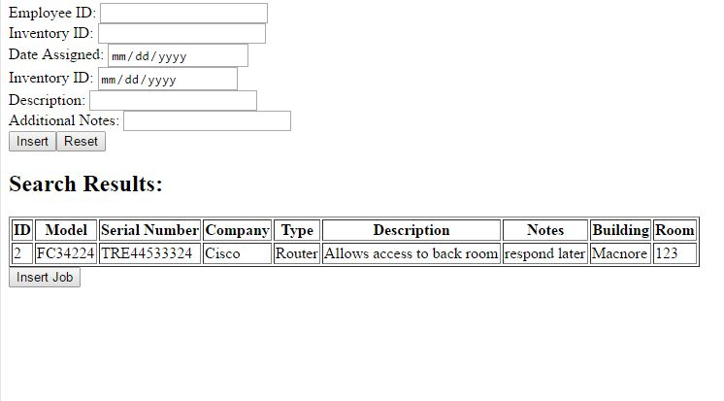
Result of word “access” inquiry

Slide 16
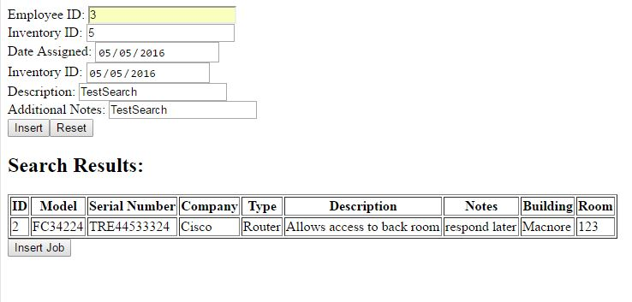
Add ticket after getting id for tech and inventory

Slide 17
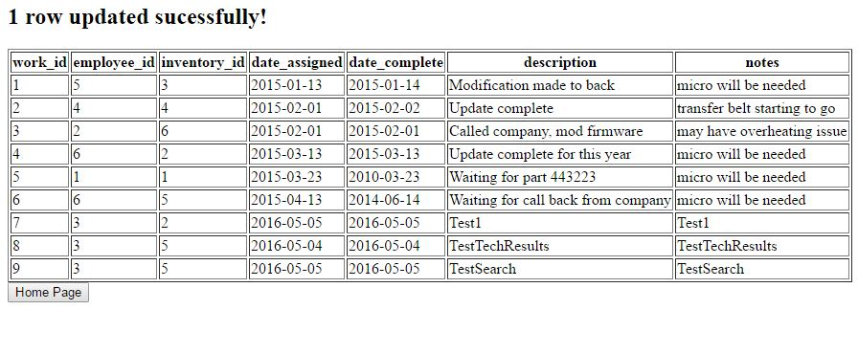
The ticket has been added

Slide 18
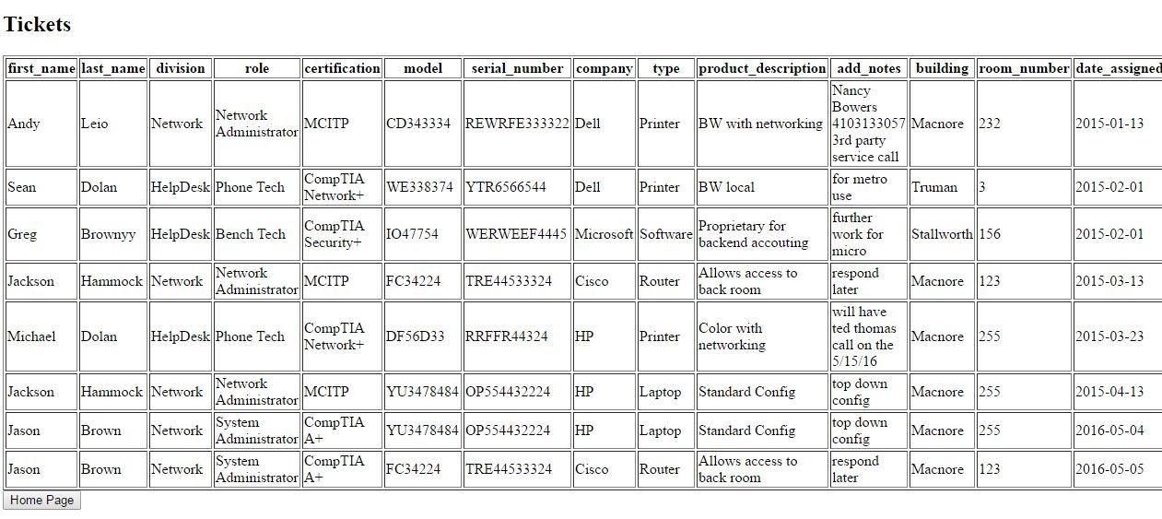
Able to view all tickets in system with customized output

Slide 19
Tech tickets homepage
pluto.hood.edu/~cwh3/index.html

